Slide 1
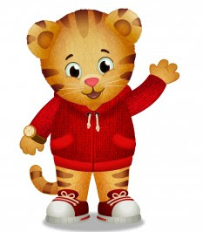
Daniel Tiger: From Ugga Mugga to Ages and Stages
Tasha Weinstein and Diane Kroeger
Notes:
Make Table Tents for Teachers of Infants, Ones, and Twos
We are public media/PBS Kids

Slide 2
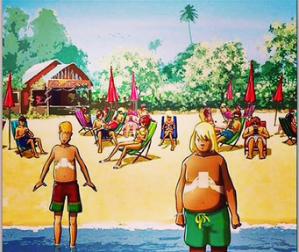
Phones Up!
Notes:
This one?

Slide 3
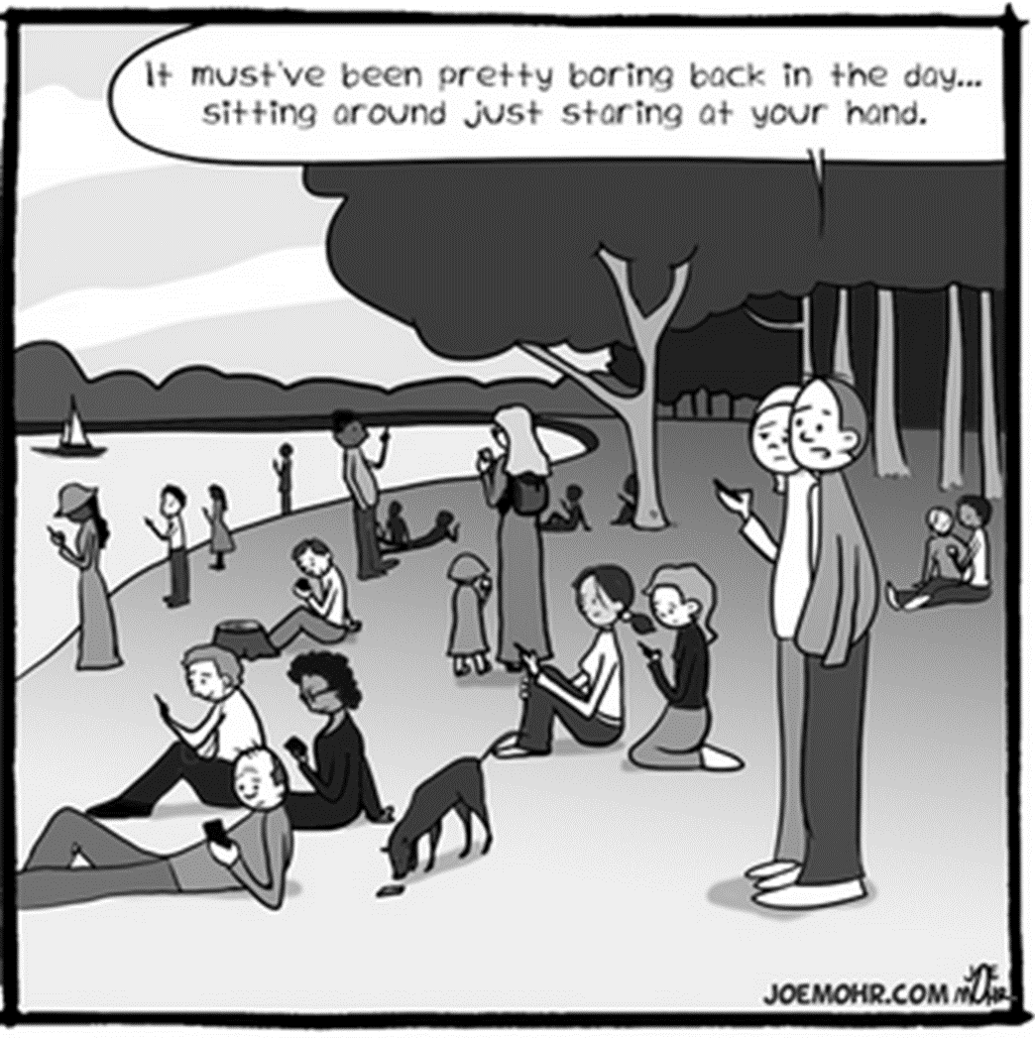
Notes:
This one?

Slide 4
Media and DAP with Infants and Toddlers:
I/T’s need hand-on exploration + social interaction
Background/passive television distracts
Heavy media use by parents/caregivers limits important interactions
Select educational media thoughtfully
Provide intentional guidance during use
Notes:
DAP= Developmentally Appropriate Practice
Fred Rogers Center and NAEYC: Special considerations must be given to the use of technology with infants and
Toddlers--recommends prohibiting the passive use of television, videos, DVDs, and other non-interactive technologies and media in early childhood programs for children younger than 2 years of age.
According to the AAP’s Media and Young Minds Policy Statement): ITs need hands on exploration and social interaction with trusted caregivers to develop cognitive language, motor and social emotional skills. They can’t learn from traditional media they way they can with their caregivers and can’t transfer digital exposure experiences to their off screen experiences.
At around 15 months, toddlers can begin learning from media IF parents/caregivers participate with them and reteach the content. Think Co-viewing and active, not passive Intake. Select media that teaches good values empathy, racial and ethnic tolerance. Choose programming that models good interpersonal skills for children to emulate.
Tasha’s Drill analogy here! Also talk about our approach-adult as moderator and the use of PBS resources for off screen activities.

Slide 5
Our Framework for Thinking about Media Use
Communication
Gross Motor
Fine Motor
Problem Solving
Personal-Social
Now available on the ELC website!
Notes:
With the AAP, Fred Rogers/NAEYC guidance and the Ages and Stages categories in mind, we want to think today about using media resources to promote high-quality interactions with Infants and Toddlers.
BTW, did you know the ELC has now made the ASQ screenings available online?
(Briefly walk through the 18 month screening tool).

Slide 6
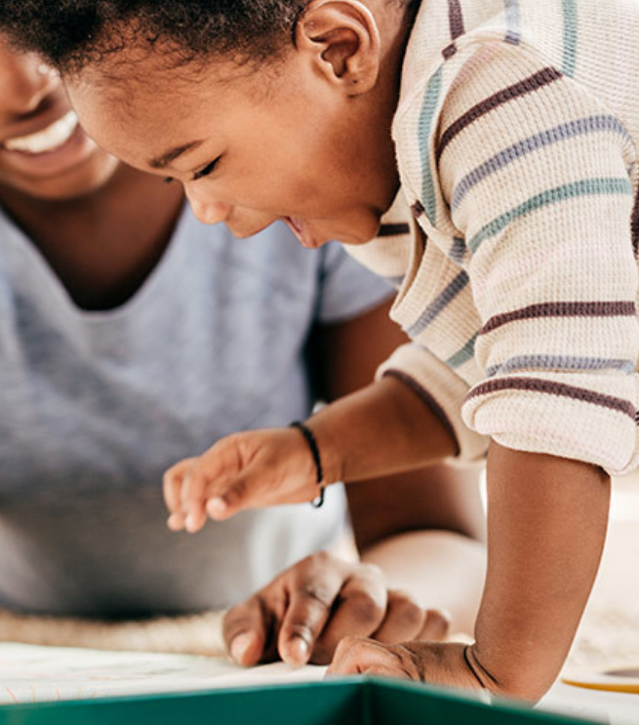
Early Brain Development
Taken from Urban Child Institute Baby’s Brain Begins Now: Conception to Age 3
Year One Cerebellum triples in size
Year One Language circuits become consolidated and are
influenced strongly by the language an infant hears
Year Two Dramatic changes- Synapses are becoming
more interconnected
Year Two Vocabulary can quadruple between ages one and two
Year Two Cognitive abilities like self-awareness are developing
The organization of a child’s brain is
affected by early environment and
experiences.
Notes:
For inspiration, let’s take a few minutes to revisit the importance of being aware of brain development in I/T’s! Don’t read the box, just focus on the blue statement!
Additional Info from the article:
Year One
Newborns can recognize human faces, which they prefer over other objects, and can even discriminate between happy and sad expressions. At birth, a baby knows her mother’s voice and may be able to recognize the sounds of stories her mother read to her while she was still in the womb. The brain continues to develop at an amazing rate throughout the first year. The cerebellum triples in size, which appears to be related to the rapid development of motor skills that occurs during this period. As the visual areas of the cortex grow, the infant’s initially dim and limited sight develops into full binocular vision.
At about three months, an infant’s power of recognition improves dramatically; this coincides with significant growth in the hippocampus, the limbic structure related to recognition memory. Language circuits in the frontal and temporal lobes become consolidated in the first year, influenced strongly by the language an infant hears. For the first few months, a baby in an English-speaking home can distinguish between the sounds of a foreign language. She loses this ability by the end of her first year: the language she hears at home has wired her brain for English.^{30,31}
Year Two
This year’s most dramatic changes involve the brain’s language areas, which are developing more synapses and becoming more interconnected. These changes correspond to the sudden spike in children’s language abilities – sometimes called the vocabulary explosion – that typically occurs during this period. Often a child’s vocabulary will quadruple between his first and second birthday.
During the second year, there is a major increase in the ability of the brain to perform more complex tasks. Higher-order cognitive abilities like self-awareness are developing: an infant is now more aware of his own emotions and intentions. When he sees his reflection in a mirror, he now fully recognizes that it is his own. Soon he will begin using his own name as well as personal pronouns like “I” and “me.”
Big take away here is: The organization of a child’s brain is affected by a child’s early experiences

Slide 7
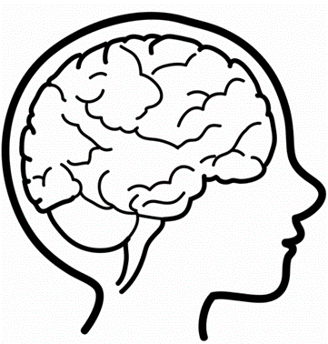
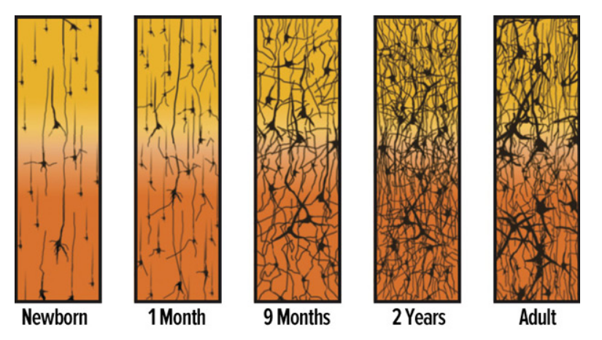
Let’s Build a Brain!
Taken from Urban Child Institute Baby’s Brain Begins Now: Conception to Age 3
Notes:
Yarn Synapse activity and recap. Then segue to resources for brain development….

Slide 8
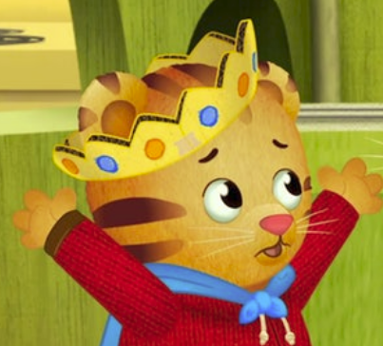
Where Can I Go for Trusted Learning Activities?
Notes:
Get your sticky notes ready! As we walk through these resources, note the ones that pertain to your children’s ASQ goals!

Slide 9
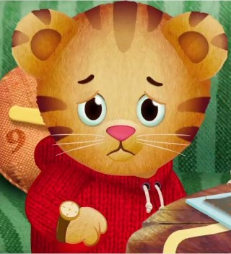
To Where Can I Direct Parents for Trusted Information?
Notes:
Get your sticky notes ready! As we walk through these resources, note the ones that pertain to your children’s ASQ goals!

Slide 10
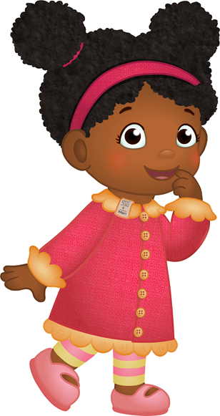
Glad You Asked!
Notes:
These are the places you and your parents can go for trusted learning interactions! Get your sticky notes ready! As we walk through these resources, note the ones that pertain to your children and their parents.

Slide 11
Sticky Note Brainstorm
Jot down the resource!
How it relates to your age group…
How might we use this with parents?
Notes:
As we tour these different resources, have participants note teaching and parenting ideas on sticky notes

Slide 12
Daniel Tiger On the Web

Slide 13
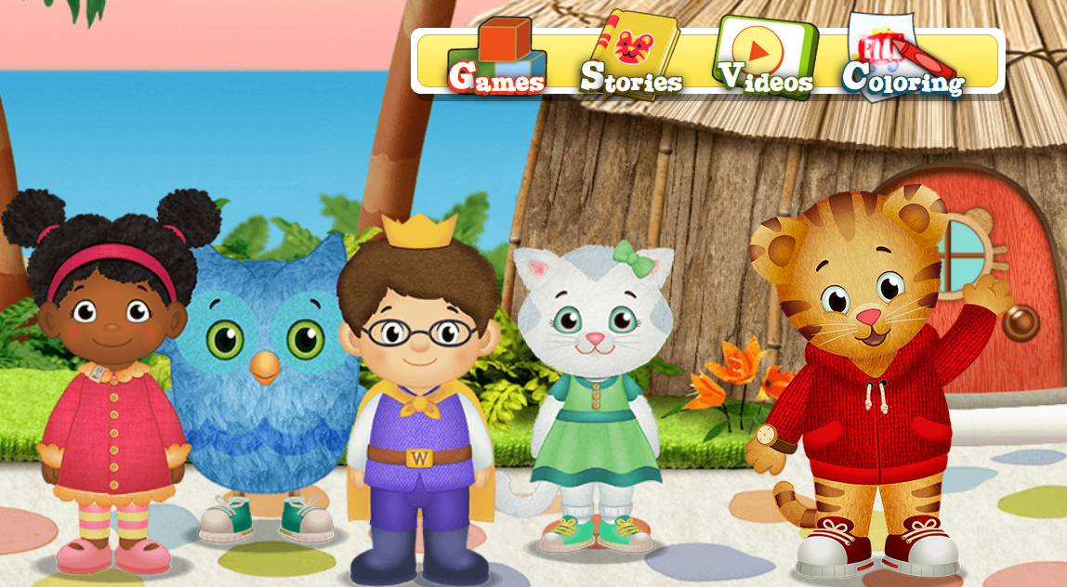
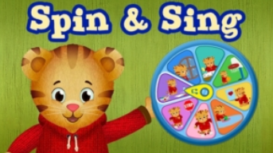
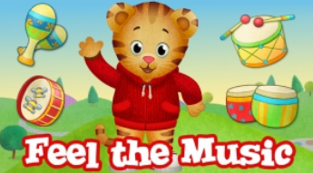
Daniel Tiger on PBS Kids.org
Notes:
Click on the link and go to Stories. Share a book together! Model Before, During and After Reading

Slide 14
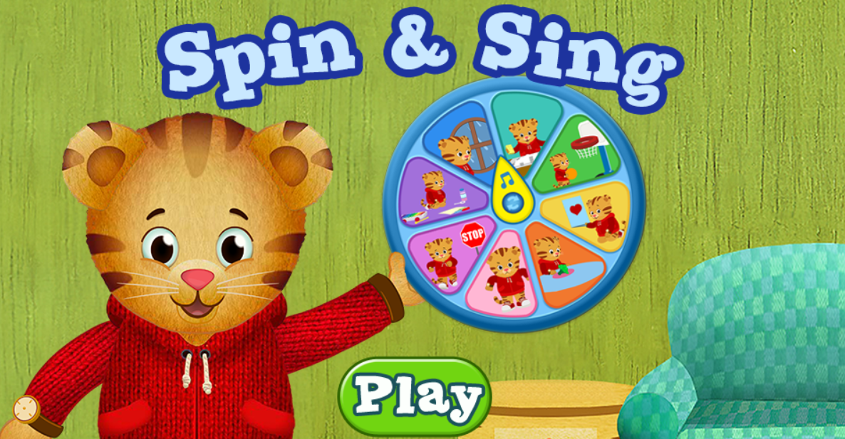
Let’s Sing!
Notes:
Click on the photo to go to Spin and Sing. These simple strategy songs can help children learn routines, manage feelings and situations. Let’s spin and try!

Slide 15
Notes:
Click blue title box. Life’s Little Lessons is a collection of resources designed for early childhood care providers and parents. Helps young children manage emotions and develop key social and emotional skills. Uses the PBS Kids model of WATCH, PLAY, EXPLORE and SHARE. Ten topics

Slide 16
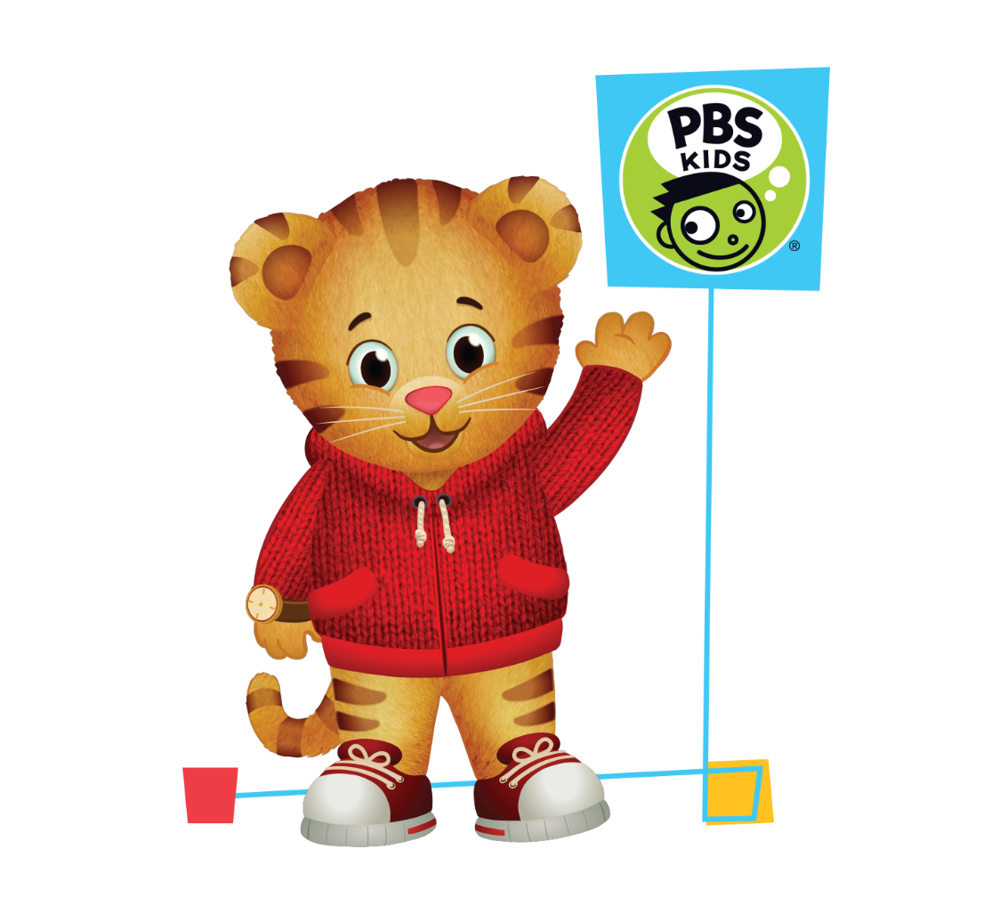
On your Mobile Device

Slide 17
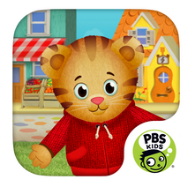
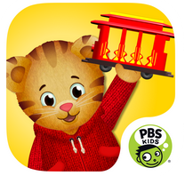
Daniel Tiger Apps
Daniel Tiger for Parents
Daniel Tiger Grrr-ific Feelings
Explore Daniel Tiger’s Neighborhood
Daniel Tiger’s Storybook
Notes:
The Daniel Tiger for Parents app empowers parents and caregivers with songs and videos from the hit PBS KIDS series Daniel Tiger’s Neighborhood.
Is your child learning about sharing? Struggling with trying a new food? Working on what to do with mad feelings? Daniel Tiger for Parents has a song for these important social-emotional skills – and many more of life’s little lessons!
Designed with busy parents in mind, the app is simple, educational and entertaining for caregivers and children. It features over two dozen Daniel Tiger songs, supporting videos from Daniel Tiger’s Neighborhood, and helpful hints for parents about the important skills children need to be ready for school and life.
Features:
Over two dozen of the most popular songs from Daniel Tiger’s Neighborhood, covering important topics like feelings, self-control, and responsibility Over 60 video clips to watch and share with your child, modeling how Daniel Tiger and his family use these songs Over 90 conversation starters and tips for parents with practical ways to use Daniel Tiger songs in every day life A custom picture frame for each song to take photos, capture the moment, and share with friends and family Available in English and Spanish
With Daniel Tiger's Grr-ific Feelings, children can play and explore their feelings through four rich, engaging activities
Children can play, sing, and learn about all kinds of feelings with their friend and neighbor Daniel Tiger from the hit PBS KIDS series, Daniel Tiger's Neighborhood.
Trolley Game – Drive the trolley to discover more than a dozen mini-games about feelings.
Sing-Along – Choose from 18 of your favorite Daniel Tiger songs, each one fully animated.
Drawing Easel – Use paints, crayons, stickers, and more to express yourself.
Feelings Photo Booth – Take pictures of yourself that show lots of different feelings. Daniel will help you pose!
Explore Daniel Tiger’s Neighborhood encourages open-ended, imaginative play as children visit familiar places and create stories about their friend Daniel Tiger. It’s like playing in a digital dollhouse where you can turn the lights on and off, open and close doors, give Daniel and his family food to eat and much more. Daniel Tiger’s Neighborhood is a land of make-believe – a place to explore and have fun!
Features:
Grocery Store – Stop by the market to pick up all kinds of fruits and vegetables. Fill your cart, check out at the cash register and help the Tiger family bag their groceries.
Music Shop – Visit Music Man Stan’s Music Shop to play with lots of different instruments. There’s a stage to put on a show and a potty to remind your child of their important bathroom routines.
Bakery – In Baker Aker’s Bakery, you’ll find delicious breads and treats. Decorate a cake, collect baked goods in your basket or find out what’s baking in the oven.
Doctor’s Office – The waiting room has dress-up hats, a fish tank and a trolley game to play. In the exam room, put Daniel on the scale and pretend with Dr. Anna’s tools. You can be the patient or the doctor!
Mini Games – In each location, there’s a special mini game to enrich the play experience. See if you can find it!
DT’s Storybook 5 Interactive Storybooks: Big Brother Daniel, Daniel Shares His Tigertastic Car, Daniel and His Friends, Daniel’s Babysitter, and Neighborhood Clean Up 2 Reading Modes: With the narration on, Daniel Tiger reads the books and children can follow the highlighted text to help develop beginning reading skills. You can turn the narration off to read the book or tell the story yourselves. Familiar songs from Daniel Tiger’s Neighborhood, including “Grownups come back” and “Clean up, pick up, put away, clean up every day.” Simple games at the end of each storybook, like helping Mom Tiger with Baby Margaret and playing peekaboo with Daniel and Tigey. Talking Tips are available for parents to help relate Daniel’s stories to your child’s everyday life. Available in English and Spanish

Slide 18
Other Tigerrr-ific Resources!

Slide 19
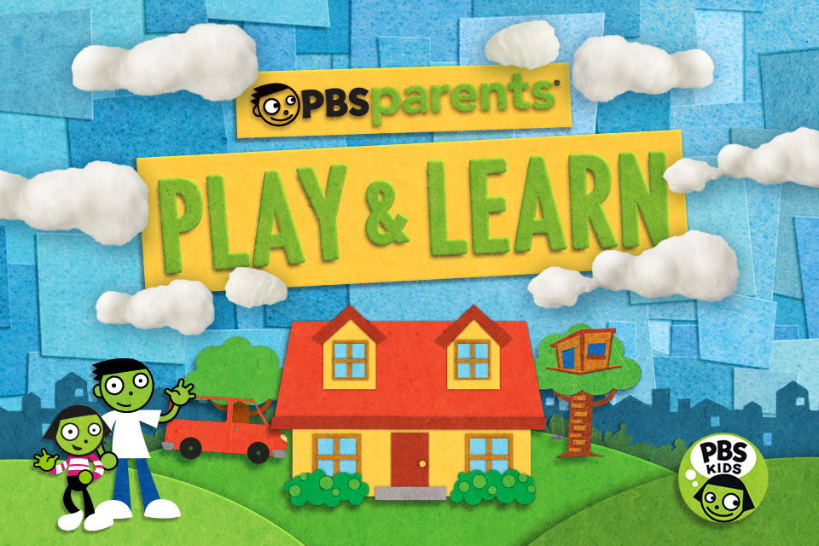

Slide 20
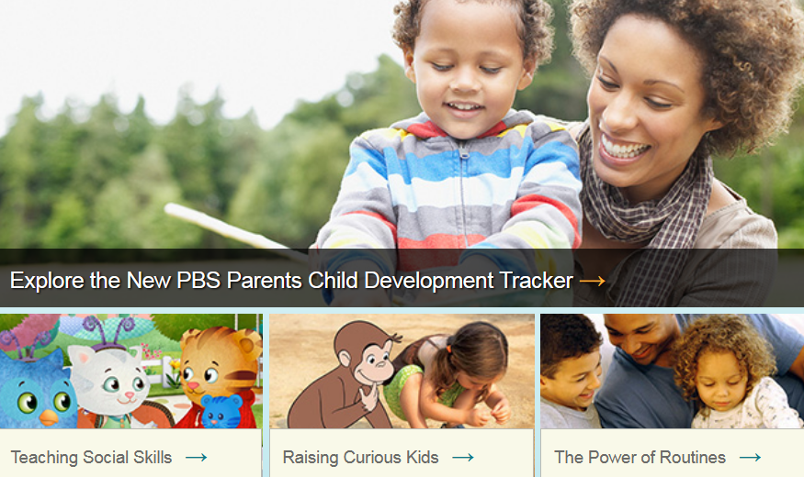
PBS Parents
Notes:
Let’s go to this site and search for information on “infants and toddlers” Scroll through results, then click on “Science with Babies and Toddlers.” Scroll through results!

Slide 21
Launch:
Late Summer
Notes:
I am excited to announce that PBS KIDS for Parents will launch end of the summer.

Slide 22
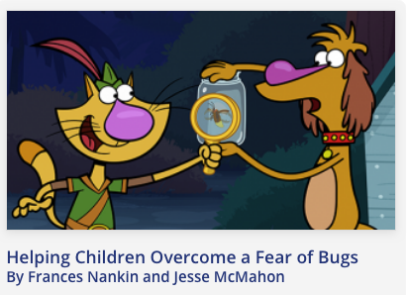
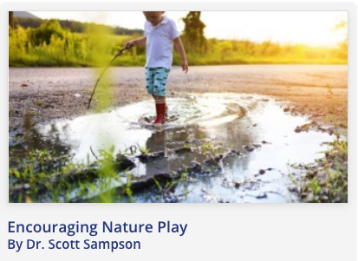
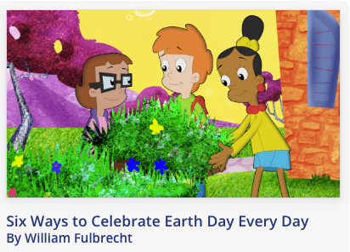
Articles
Notes:
Over the past year we’ve worked with some of you and your advisors to create new articles.

Slide 23
PBS Pre-School U

Slide 25
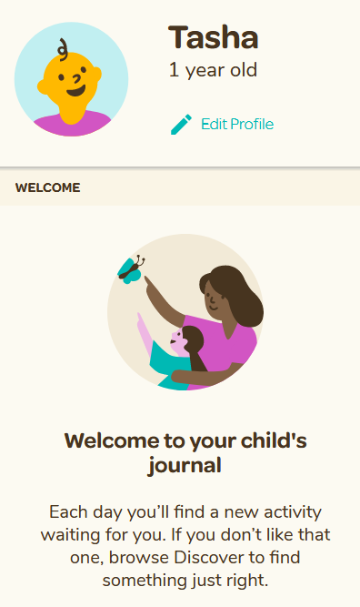
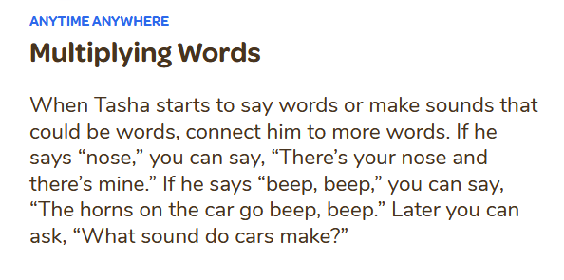
Notes:
Click on Vroom logo to go to website

Slide 26
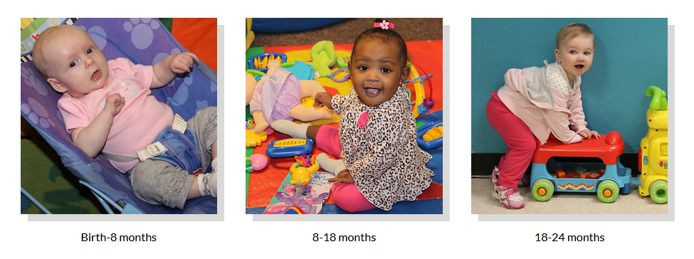
Florida Early Learning and Developmental Standards
Notes:
If we have time….

Slide 27
Florida Early Learning and Developmental Standards
Notes:
If we have time….Office of Early Learning breaks the standards into 8 domains. Did you know there’s a Scientific Inquiry standard for babies from birth to 8 months? Uses senses to explore and understand their social and physical environment? Benchmark a. Responds to information received through the senses

Slide 28
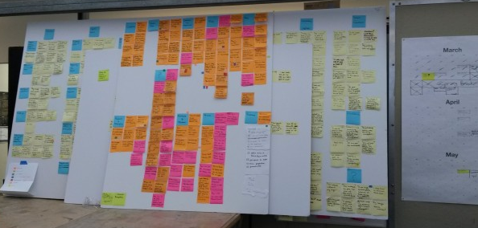
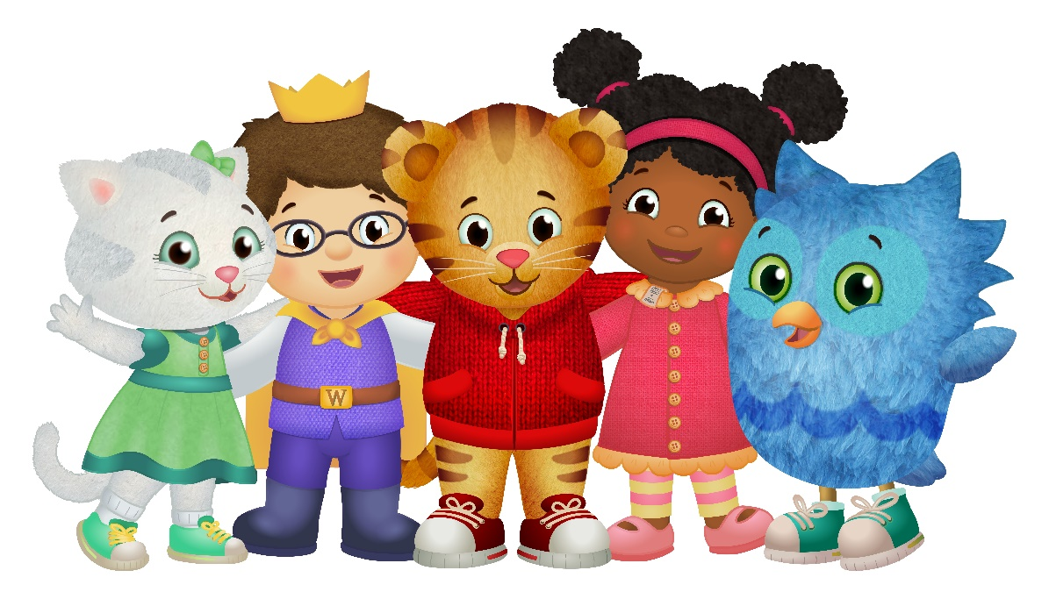
Let’s Consolidate and Share our Ideas!
Notes:
Participants post their notes on the wall. Using our tablets and participants’ smart phones, allow participants to search back through the seven main resource sites for additional ideas. Ask for a volunteer or two to come help categorize stickies and report back to the group what the results are.

Slide 29
Build Your Resource Binder!
This binder can help you share with your parents!
DAP!
Organize using the construction paper as dividers
Make copies and share
Add to it as you gather more treasures!

Slide 30
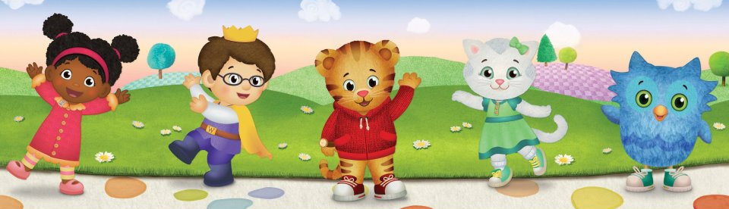
Thank you!
What’s your favorite go-to Social Media for sharing all of this info: Facebook? Pinterest? Website?
Share with us using a post-it please!
Notes:
All notes get

