Slide 1
Gobble! Gobble!
Giving Thanks All Year Long!

Slide 2
G is for Gratitude
Properly understood, gratitude is the giving of thanks, the ‘willing of good’. It works miracles.
Studies find that those who make a conscious effort to keep a regular gratitude journal enjoy better health, increased happiness and more loving relationships.
So, as Kipling advised, ‘Delight in the little things’, and write them down. Arthur Poetry link!
Rather than waiting for the big things to happen – the promotion, the bigger house, the lottery win – be grateful for the smaller things: a cup of tea when you didn’t ask for it, the compliment that you didn’t expect, the warm hug on a cold day. For these are the things of which life, and love, are made.

Slide 3
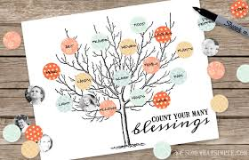
Delight in the Little Things
Blessings Tree

Slide 4

PBS Learning Media Holidays and more…

Slide 5
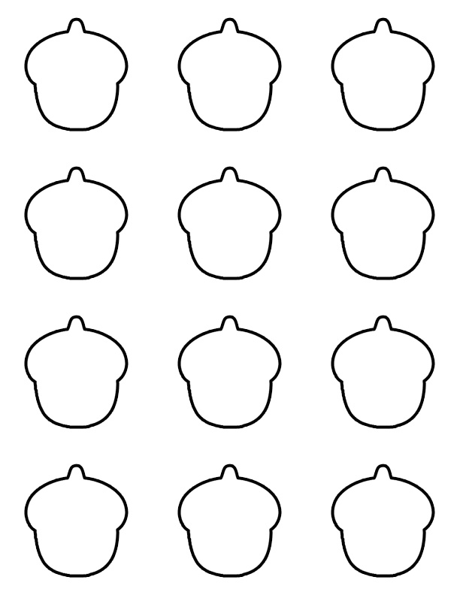
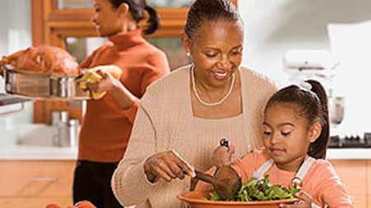
Count Your Blessings
Research shows that those who keep a gratitude journal can lift their happiness levels by as much as 25%.

Slide 6
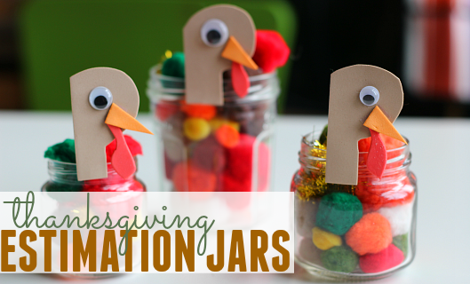
More Counting…

Slide 7
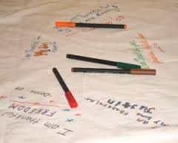
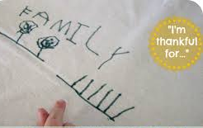
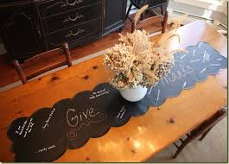
Gratitude Tablecloth
I am Grateful for….

Slide 8
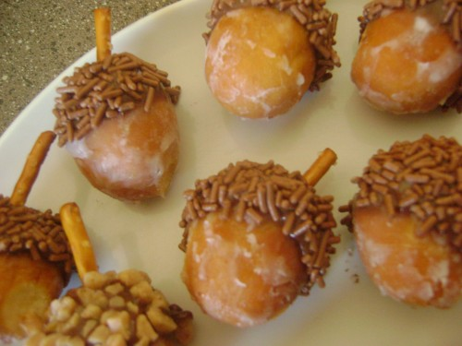
Acorn Sweets

Slide 9
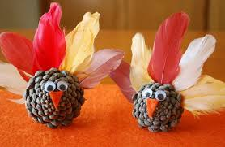
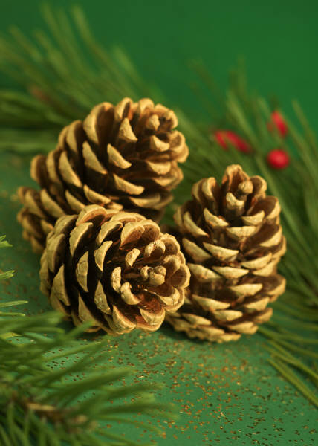
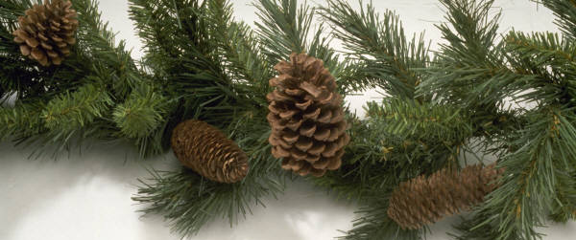
Pinecone Turkeys
Pinecone Science!

Slide 10
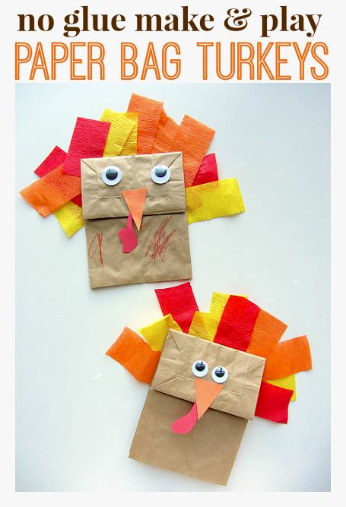
Paper Bag Turkeys

Slide 11
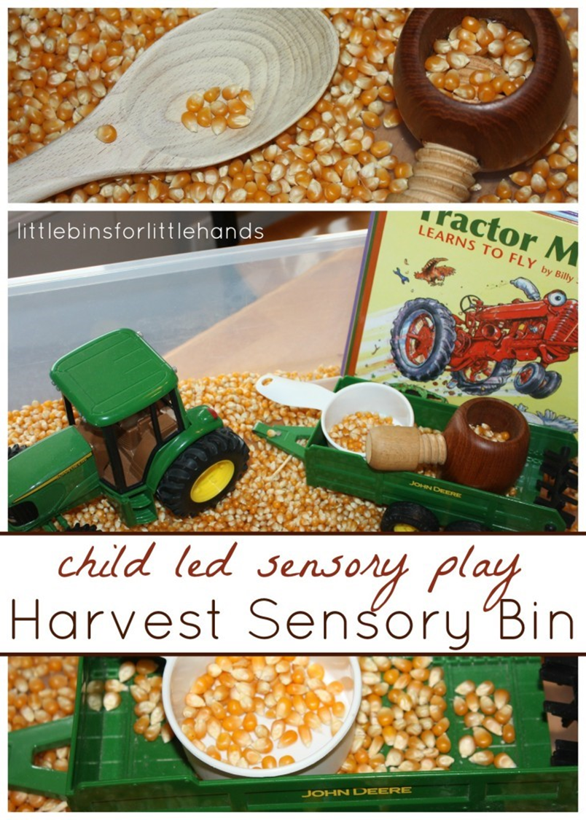
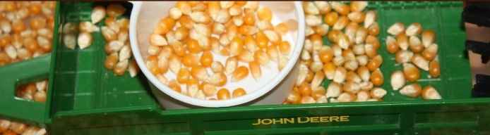
Sensory Bin Fun!

Slide 12
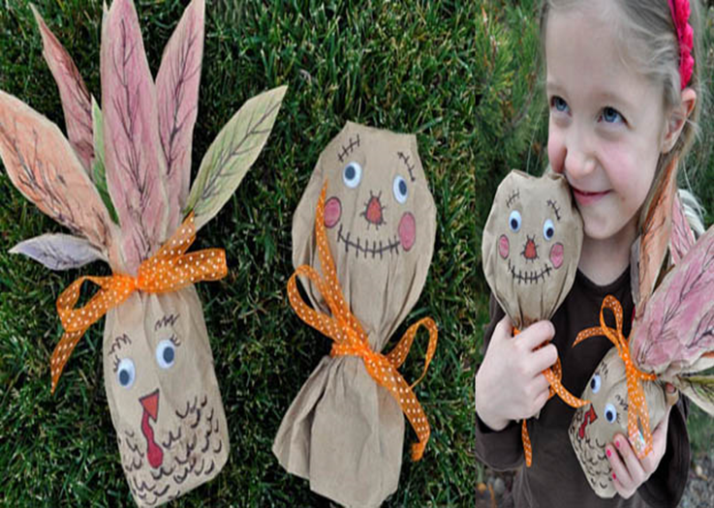
Shaker Craft
Scarecrow

Slide 13
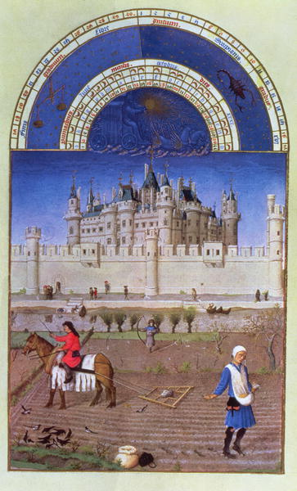
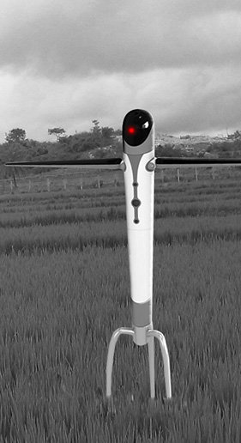
Scarecrow
History

Slide 14
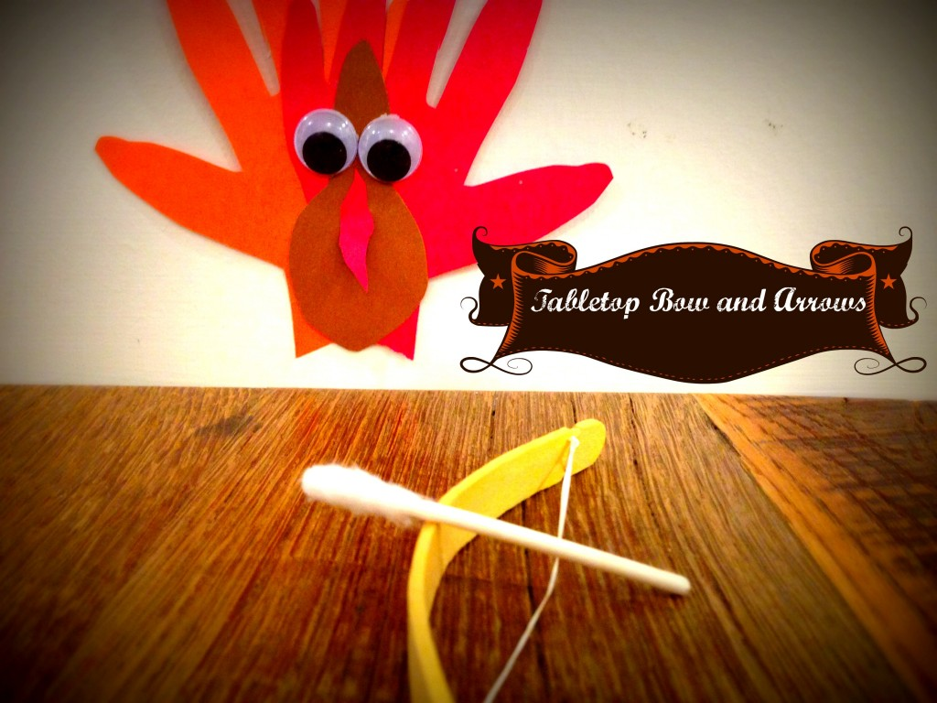
Tabletop Bow & Arrows

Slide 15
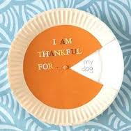
Thankful Pie for older kiddos…

Slide 16
Thank you!
Tasha Weinstein
tweinstein@fsu.edu
WFSU
1600 Red Barber Plaza
Tallahassee, Florida

