Slide 1
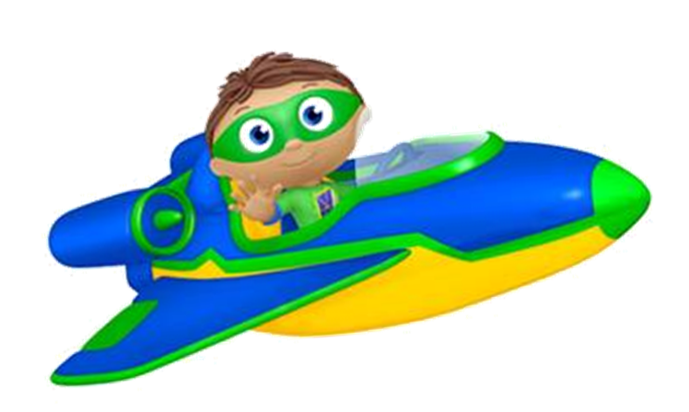

S… is for Summer
& for SUPER WHY
Transforming Pre-Schoolers into Super Readers
1 episode at a time…
May 8th, 2014

Slide 2
What is different for you in the Summer?

Slide 3

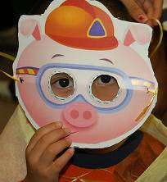
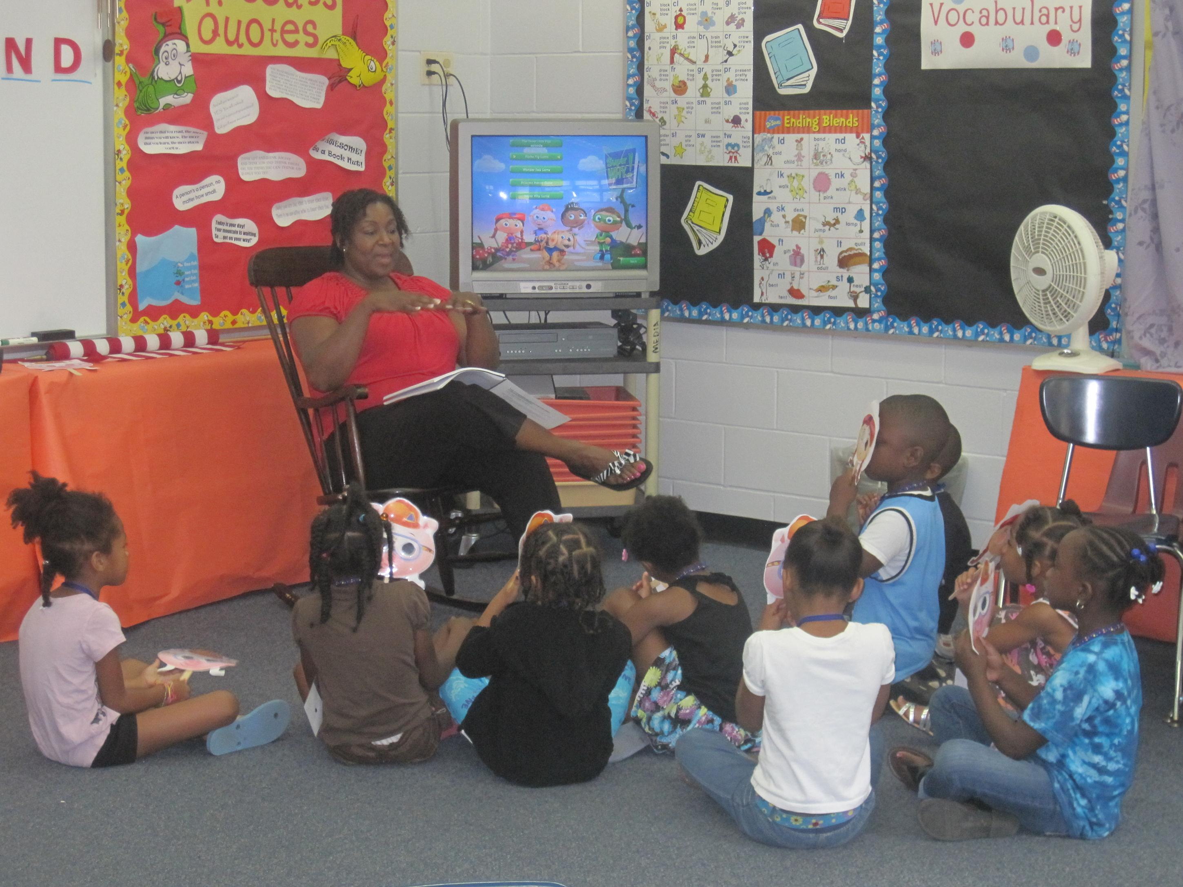
SUPER WHY Reading Camp
SUPER WHY Reading Camp is a national literacy program that features an engaging curriculum of interactive reading games and activities that build upon the skills and content taught in the series:
Hundreds of camps have been held since 2007, reaching thousands of children in more than 50 cities, targeted to low-income families. WFSU, along with Bond Elementary and St. Johns in Gadsden County were among the 1st research projects!

Slide 4
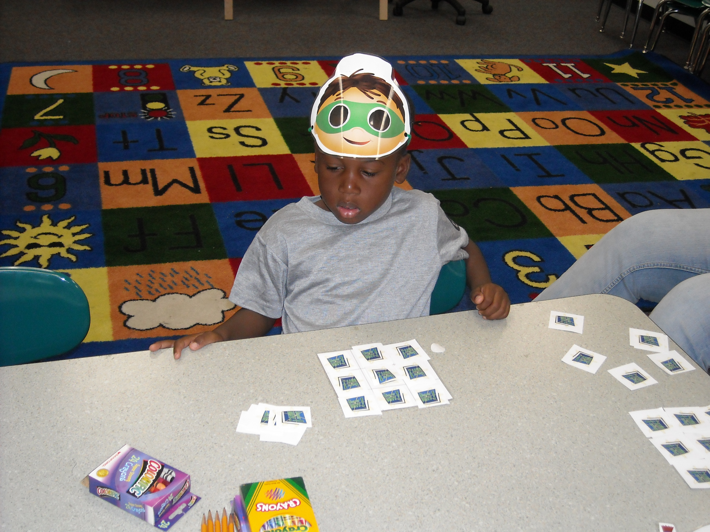
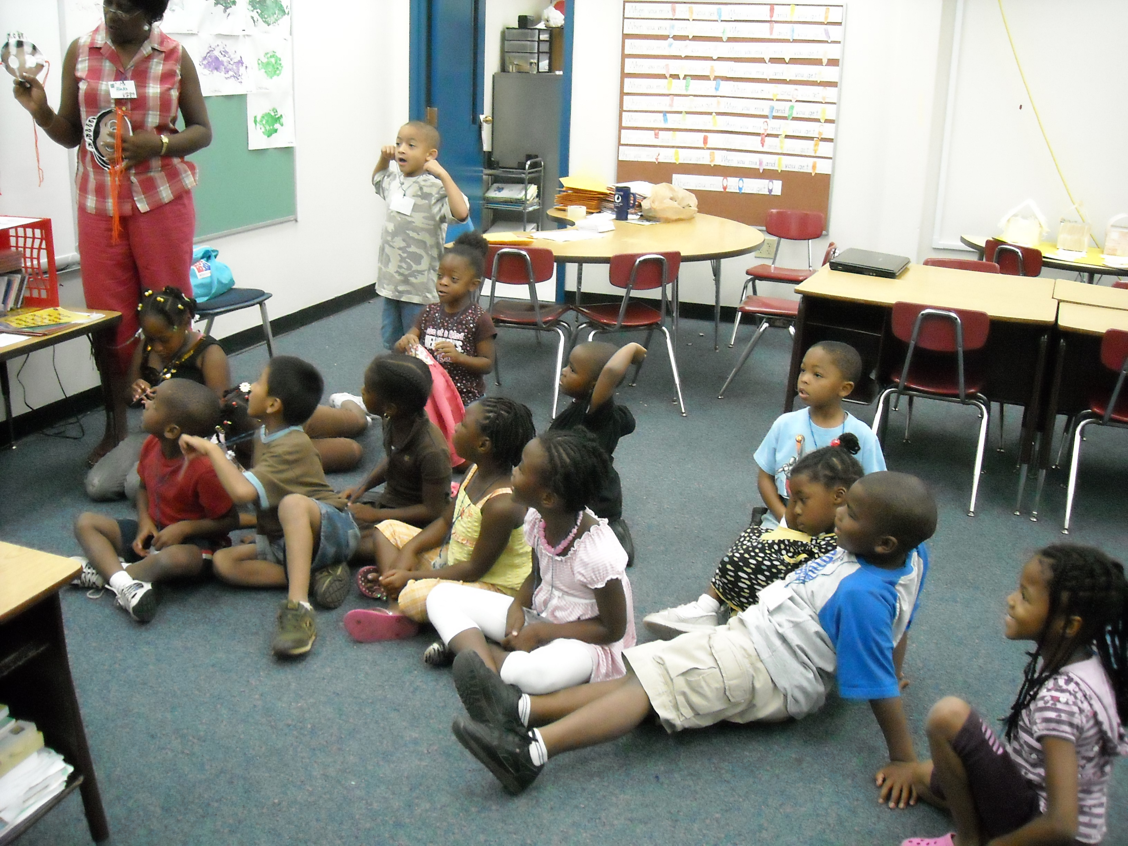
Camp Characteristics…
SUPER WHY Reading Camps was developed to fit in with the needs of schools and teachers!
  *Scripted curriculum, instructions, and materials
  provided to camp instructors (SCRIPTS)
  *SUPER WHY DVD clips, craft materials, manipulatives, worksheets, costume characters, etc. (PROPS)
  *Designed to be either a free standing camp or
  an add-on to an existing program
  (ACTION)
  *Experienced Teachers make for minimal training requirements! (CASTING)

Slide 5
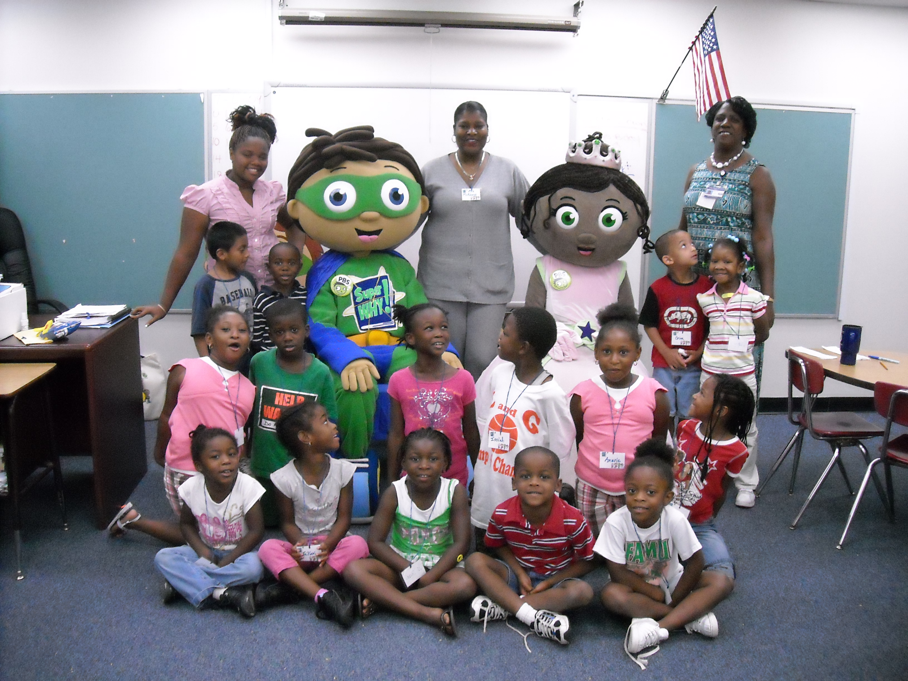
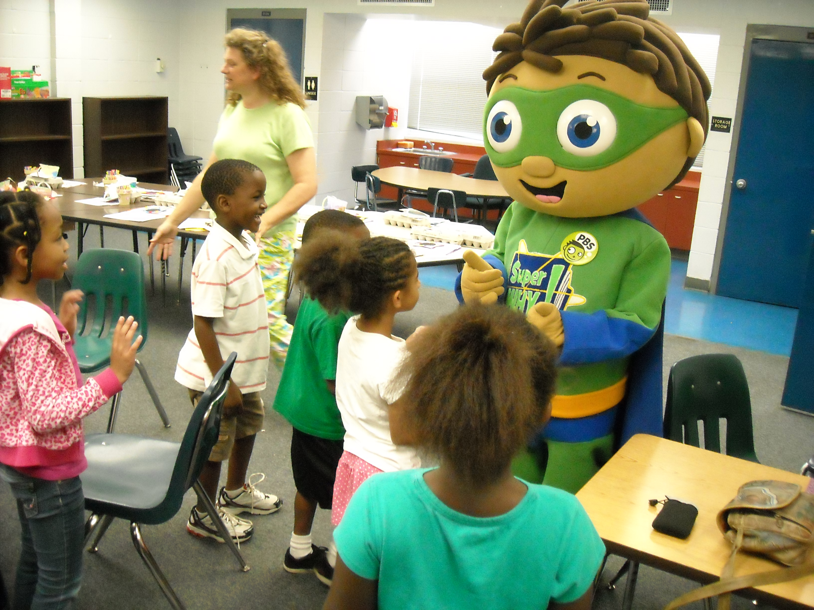
Age-Appropriate Program
Each camp is designed for fifteen children:
  Overall program targeted to 3- to 6-year-olds, with 4-5 as the core
  Scaffolded content covers a range of ages/skill levels within the
  preschool demographic
  Curriculum activities and take home materials geared to reading level of campers and low income parents/caregivers

Slide 6
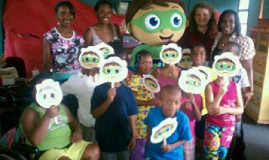
Elements of Each Camp Session
Each 3.5-hour camp session consists of:
  Viewing the full SUPER WHY episode
  Transforming into the Super Reader characters
  Playing interactive SUPER WHY literacy games
  Creating SUPER WHY-themed crafts
  Learning and singing songs from the SUPER WHY show
  Participating in SUPER WHY-based body movement exercises
  Reviewing what was learned
  Taking home SUPER WHY extended
  learning worksheets (optional)

Slide 7
Modifying Elements for Daily Use!
  Viewing the full SUPER WHY episode 23 minutes
  Transforming into the Super Reader characters 5 minutes
  Playing interactive SUPER WHY literacy games 15 -30 minutes
  Creating SUPER WHY-themed crafts 30 -50 minutes
  Learning/singing songs from the SUPER WHY show 10 minutes
  SUPER WHY-based body movement exercises 5 – 10 minutes
  Reviewing what was learned 5 – 10 minutes
  Taking home SUPER WHY extended 10 - 20
  learning worksheets (optional). You can use these as in class worksheets.
You can design your own…

Slide 8

Reading Camp Weekly Format
Campers transform into one of the SUPER WHY literacy-based superheroes each day to play learning games, activities, and crafts themed to that character’s literacy domain:
  Day 1: Alpha Pig Day – Letter Identification
  Day 2: Wonder Red Day – Decoding / Rhyming, Word Families
  Day 3: Princess Presto Day – Encoding / Spelling
  Day 4: Super Why Day – Vocabulary, Reading Comprehension
  Day 5: Super You Day – Review the week’s fun and play favorite games

Slide 9
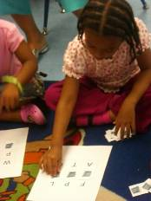
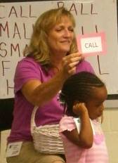
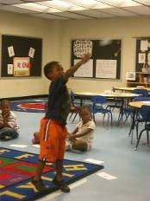
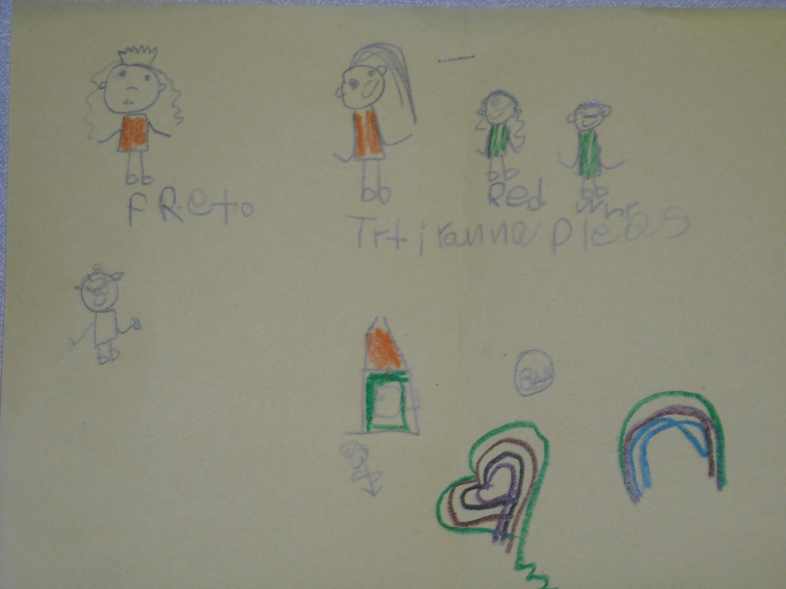
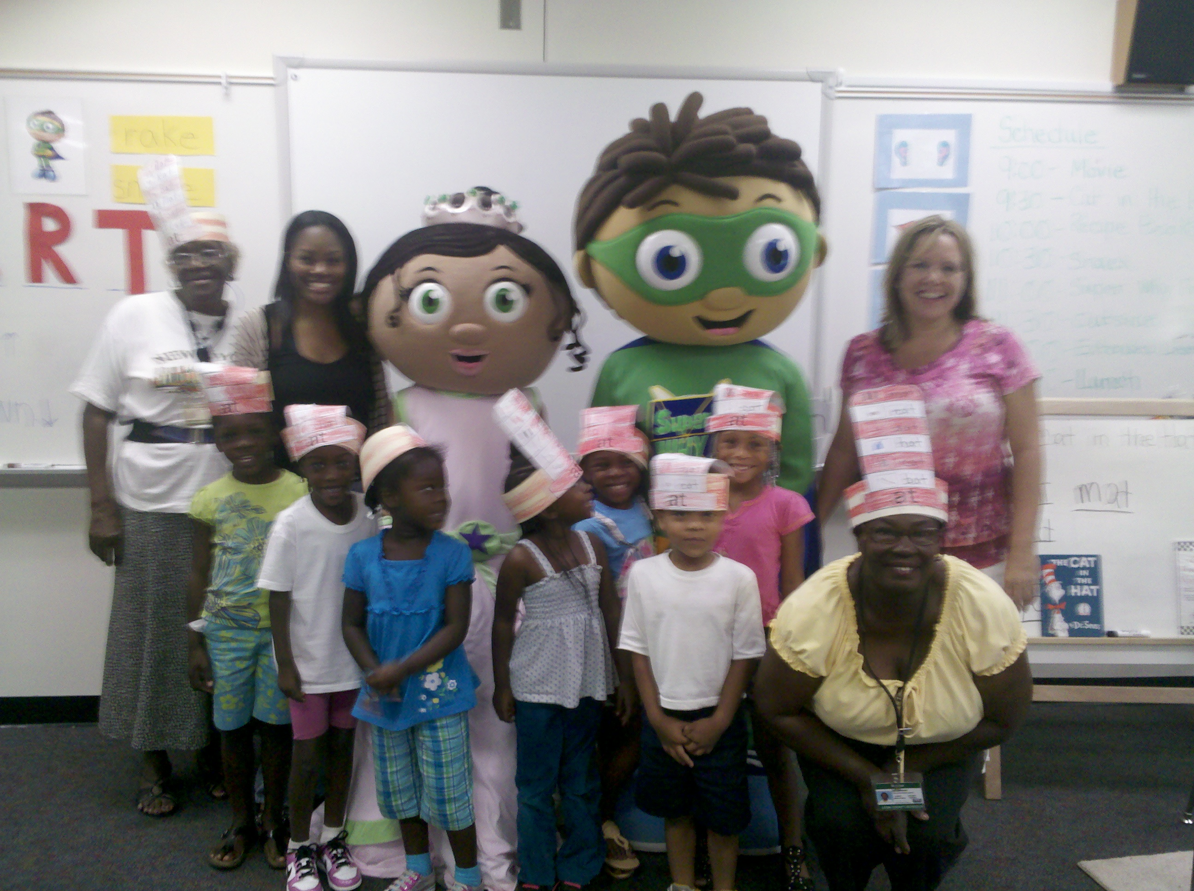
Lickety Literacy Skills
Each day of the program is themed to a different SUPER WHY character and literacy skill:
Day 1: Letter Identification
Day 2: Word Families
Day 3: Spelling
Letter Sounds Basketball
Word
Charades
Letter Identification
BINGO
Day 4: Reading Comprehension
Visit with Super Why Day
Draw Your Own Adventure
Super You Photo Op
Notes:
Each day the kids watch the show, then transform into one character and practice his/her skill. Role play is important part of the brand.
they play out that character’s game and participate in extended learning activities that take that skill and apply it to popular games like Bingo, Charades, Basketball, and Relay
- on the last day, parents are invited to watch their children perform the games that they learned during the week
children and families get to meet a SW costume character and participate in a photo op
We’ve developed a lot of material that can be repurposed, it’s a constantly evolving program, so we can look to develop new games and activities to refresh it

Slide 10

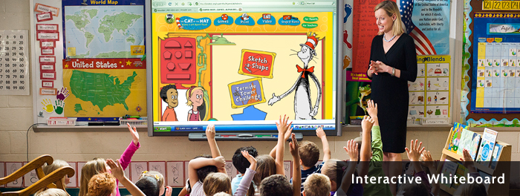

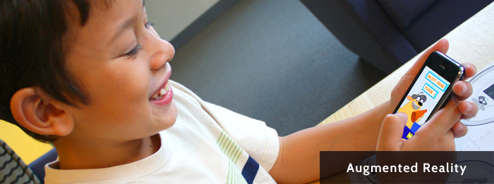

Extended Learning!
Notes:
10

Slide 11
Reading Camps Assessment Results
Lots of research has been done on Super Why Summer Reading Camps since 2008. Original analysis included data from 1,273 campers who attended 113 camps across the United States… including ours in Leon and Gadsden County!
Across all students, significant gains were made from pre- to post- assessments for ALL skills tested!
WFSU conducted our own Assessment Analysis on camps held during 2012. A total of 149 campers participated via 11 Super Why Summer Reading Camps held at Apalachee, Astoria Park, Bond, Ft. Braden, Hartsfield, Oak Ridge, Pineview, Riley, Ruediger, Sabal Palm and Woodville Elementary Schools.
“Participants as a whole scored significantly higher on all post-assessments suggesting that the weekly activities conducted helped participants increase their scores.”
New Super Why Data for 2013!
Notes:
Beth Phillips at the Florida Center for Reading Research analyzed the data from student assessments in 2008. Kids should statistically significant gains across all skills taught.
- Not only are kids having fun and interacting with the brand, they are learning, which shows we are satisfying the DOE’s objectives.

Slide 12
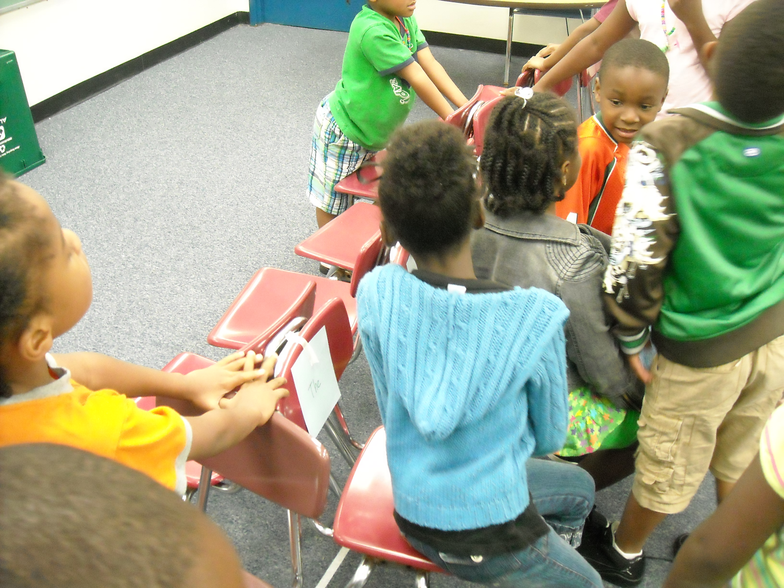
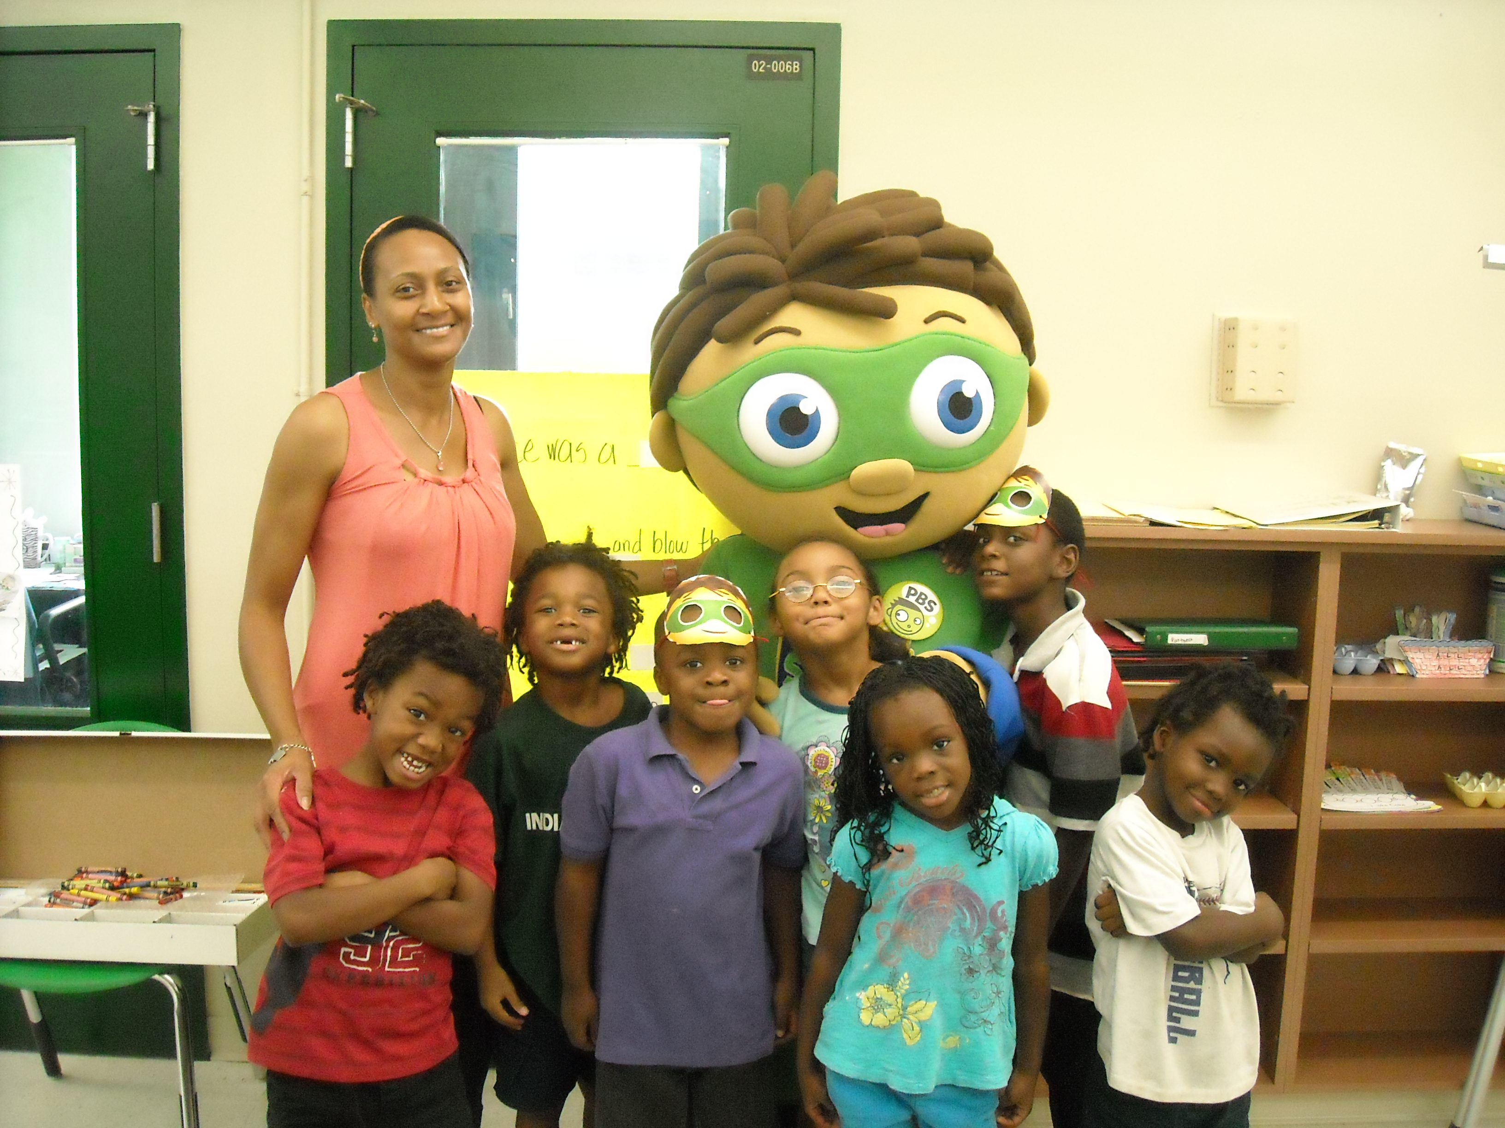
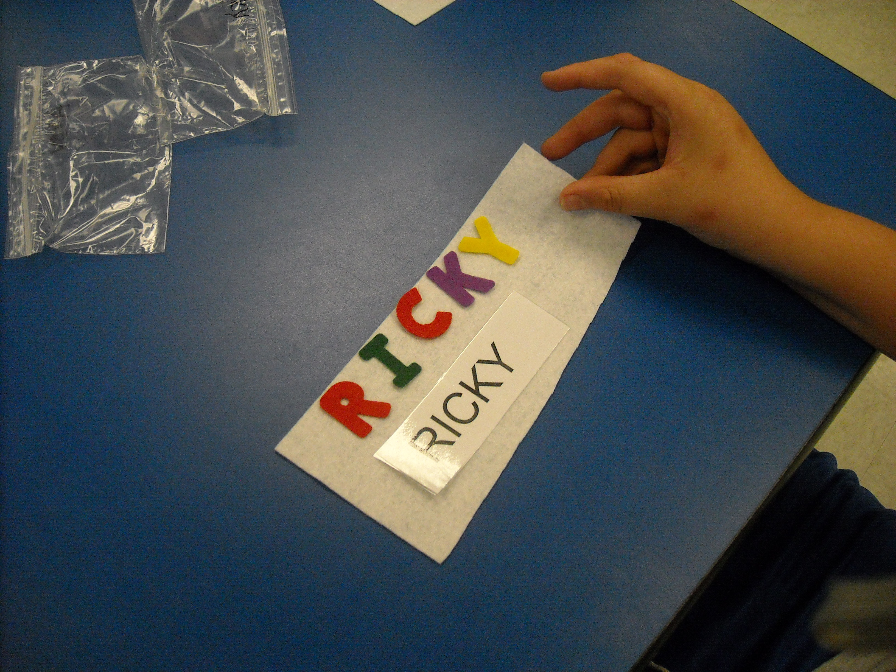
Camp Feedback
Feedback from the Parents, Stations and Facilitators Surveys is always very positive…
Parents report that campers did not want to come home at the end of the day because they were having too much fun!
Campers gained social and reading skills.
Outcomes were consistent with the goals of the camps, including successfully introducing and reinforcing reading readiness concepts that helped children view themselves as readers!

Slide 13



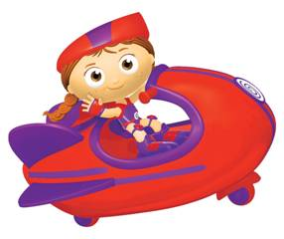
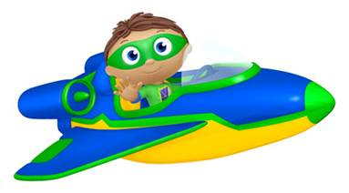
SUPER READERS...TO THE RESCUE!

Slide 14

It all begins with the program…
Building educational activities locally from the broadcast programs provides a connection for children and families that they can access anytime!
Notes:
1. At IPTV, we often build from the broadcast for our local educational activities. Using this approach provides a connection for children and families.

Slide 15
Mix it Up!
There are 3 weeks of content +
Over 50 activities (crafts, games etc.)
3 programs are used but Super Why has 81 episodes to pick from for ideas and curriculum prompts!
Additional projects are listed at: http://www.pbs.org/parents/superwhy/activities/index.html

Slide 16
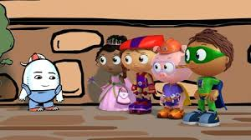
Humpty Dumpty
Letter Hunt
Letter Picnic
Letter Ladder
http://www.pbs.org/parents/superwhy/resources/index.html

Slide 17


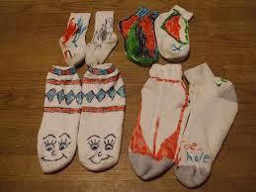
Molly’s Dance Show
Sock Hop Activity

Slide 18
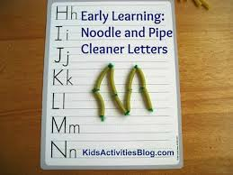
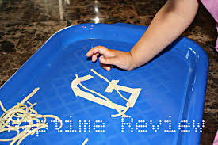

King Eddie Who Loved Spaghetti

Slide 19

Summer Schedule!

Slide 20


Slide 21
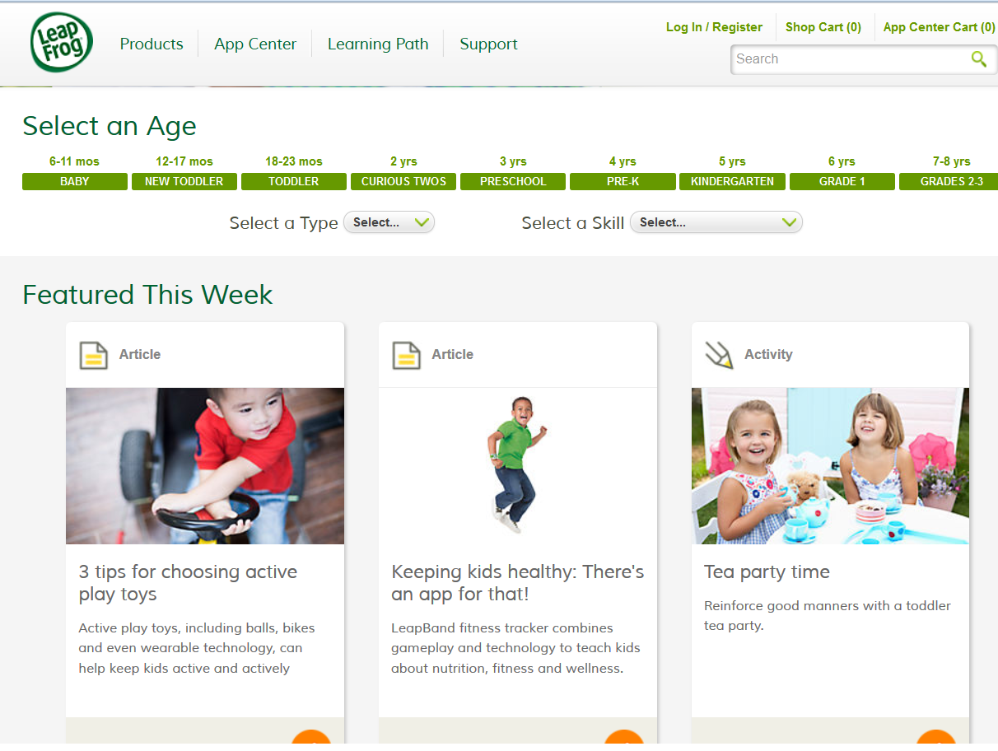

Slide 22
THANK YOU!
Tasha & Sarah
Next Workshop! What date is better:
Tuesday, July 15th or Thursday, July 17th?
Topics! New Sesame Street Kit… Moving Away
Summer Fun – Outdoor Activities like Cloud Clay and much more!!

