Slide 1
Valentine’s Day Workshop
With Tasha Weinstein, Becca Piers, and Jacob Suberman
Notes:
Before we get started, we need to put on our “love goggles”

Slide 2
Love Goggles

Slide 3
History of Valentine’s Day

Slide 4
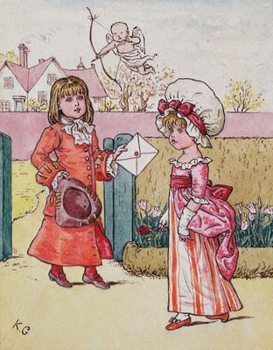
History of Valentine’s Day
The custom of choosing a sweetheart on this date spread through Europe in the Middle Ages, and then to the early American colonies.
During the 1700s, on Valentine’s Day young men wrote the name of their sweetheart on their sleeve, a practice that is probably the origin of the saying, “wearing his heart on his sleeve.”
Notes:
Heart on Sleeve Craft

Slide 5
Snack Time

Slide 6
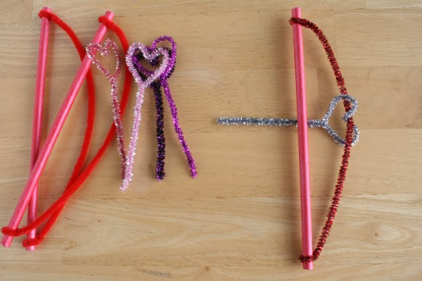
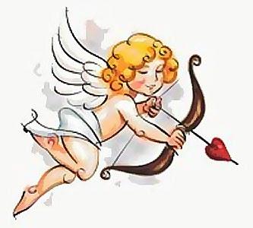
History of Valentine’s Day “Cupid”
One of the earliest symbols for Valentine’s Day
Roman god of Love

Slide 7
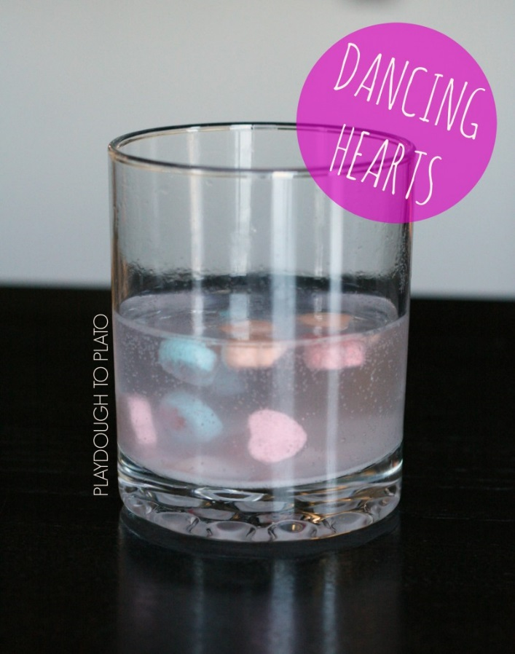
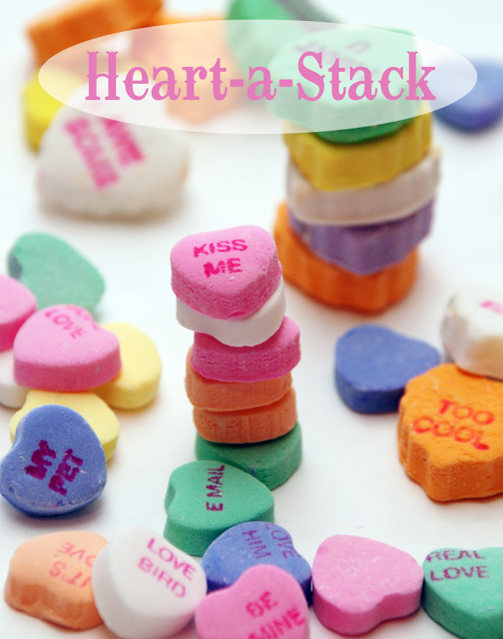
Valentine’s Game!

Slide 8
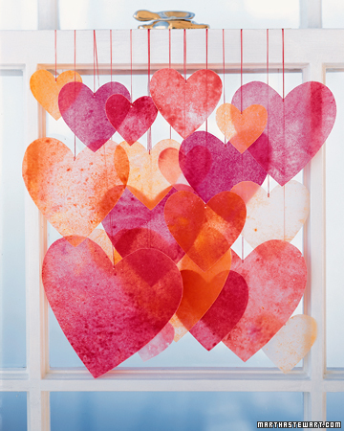
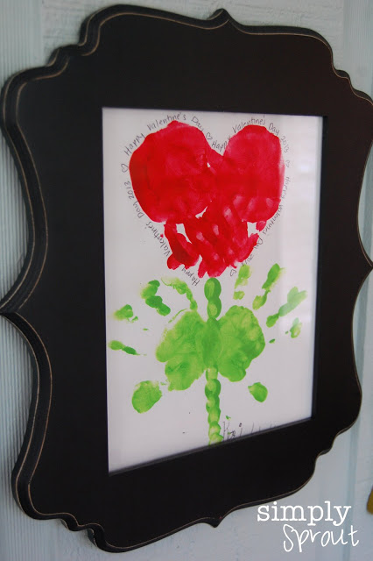
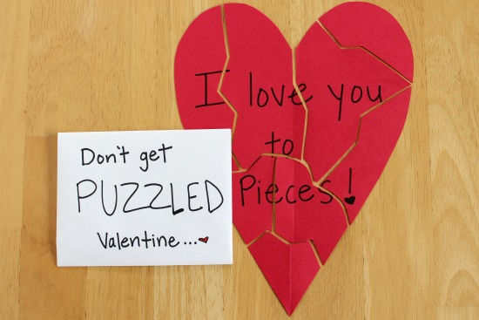
The Most Popular Symbol of Valentine’s Day?
HEARTS
Daniel Tiger Song

Slide 9
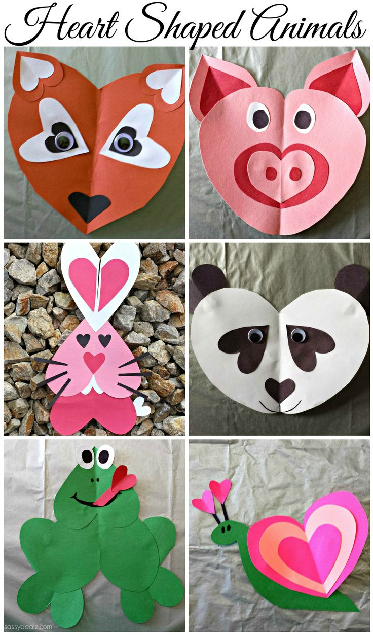
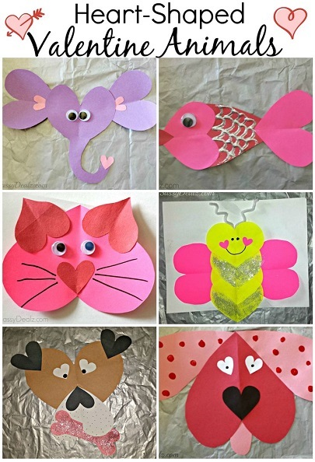
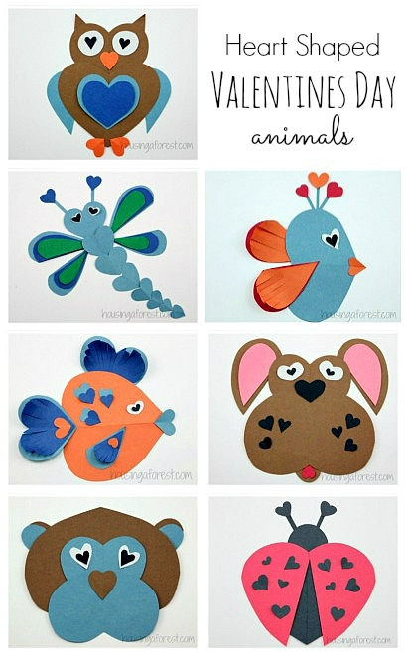

Slide 10
Valentine’s Letter Game!

Slide 11
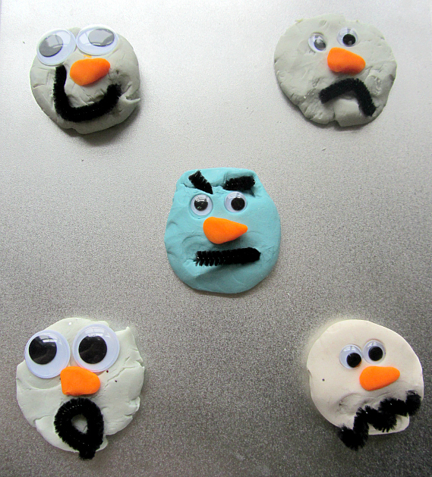
Emotions
How Do You Feel?
What do you do when one of your kids is angry? How do you encourage self-control?
What do you do when one of your kids is sad?
What do you do when one of your kids is happy?
Daniel Tiger “Use Your Words”

Slide 12
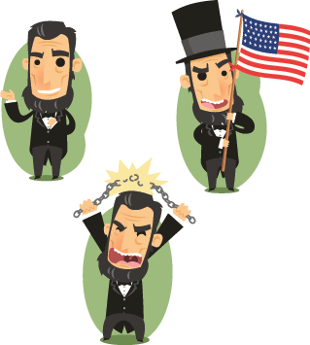
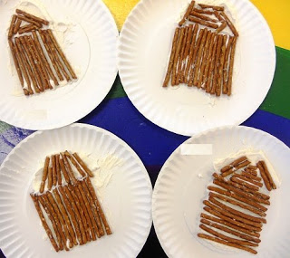
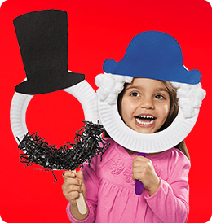
President’s Day

Slide 13
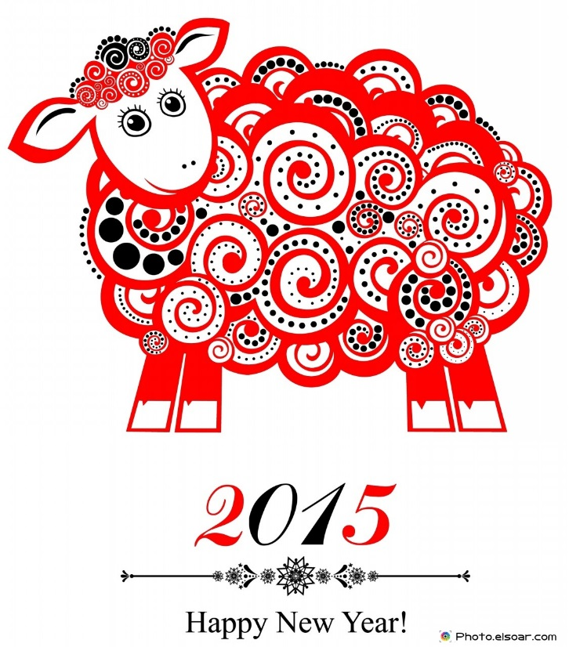
Chinese New Year
Postcards from Buster
Chinese New Year 4713
This year, it is celebrated on February 19th
Year of the Goat/Sheep/Ram

Slide 14
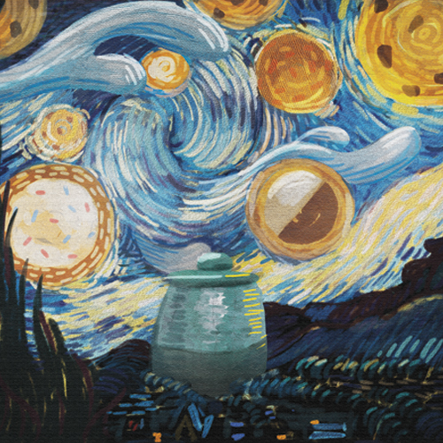
Thank you for coming!
Our next workshop will be February 26 on St. Patrick’s Day and our newest Cookie Monster Special!

